Slide 2

Applied Algorithm Lab
Nurse

Slide 3
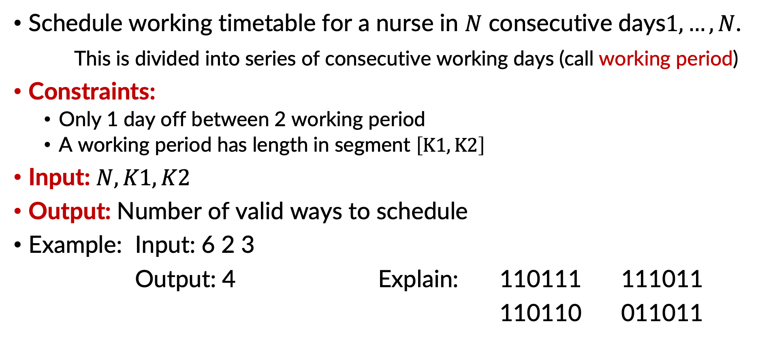
Nurse
Schedule working timetable for a nurse in $N$ consecutive days$1,…, N$.
This is divided into series of consecutive working days (call working period)
Constraints:
Only 1 day off between 2 working period
A working period has length in segment $\left[K1, K2\right]$
Input: $N, K1, K2$
Output: Number of valid ways to schedule
Example: Input: 6 2 3
Output: 4 Explain: 110111 111011
110110 011011

Slide 4
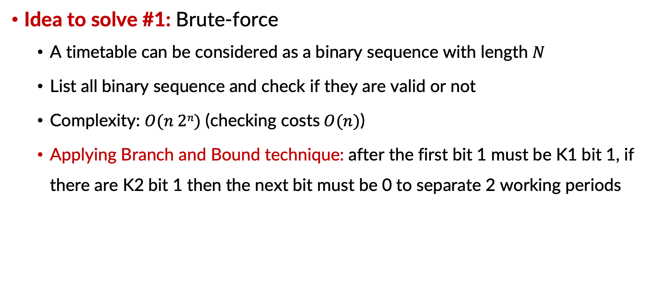
Nurse
Idea to solve #1: Brute-force
A timetable can be considered as a binary sequence with length $N$
List all binary sequence and check if they are valid or not
Complexity: $O(n 2n)$ (checking costs$O(n)$)
Applying Branch and Bound technique: after the first bit 1 must be K1 bit 1, if there are K2 bit 1 then the next bit must be 0 to separate 2 working periods

Slide 5
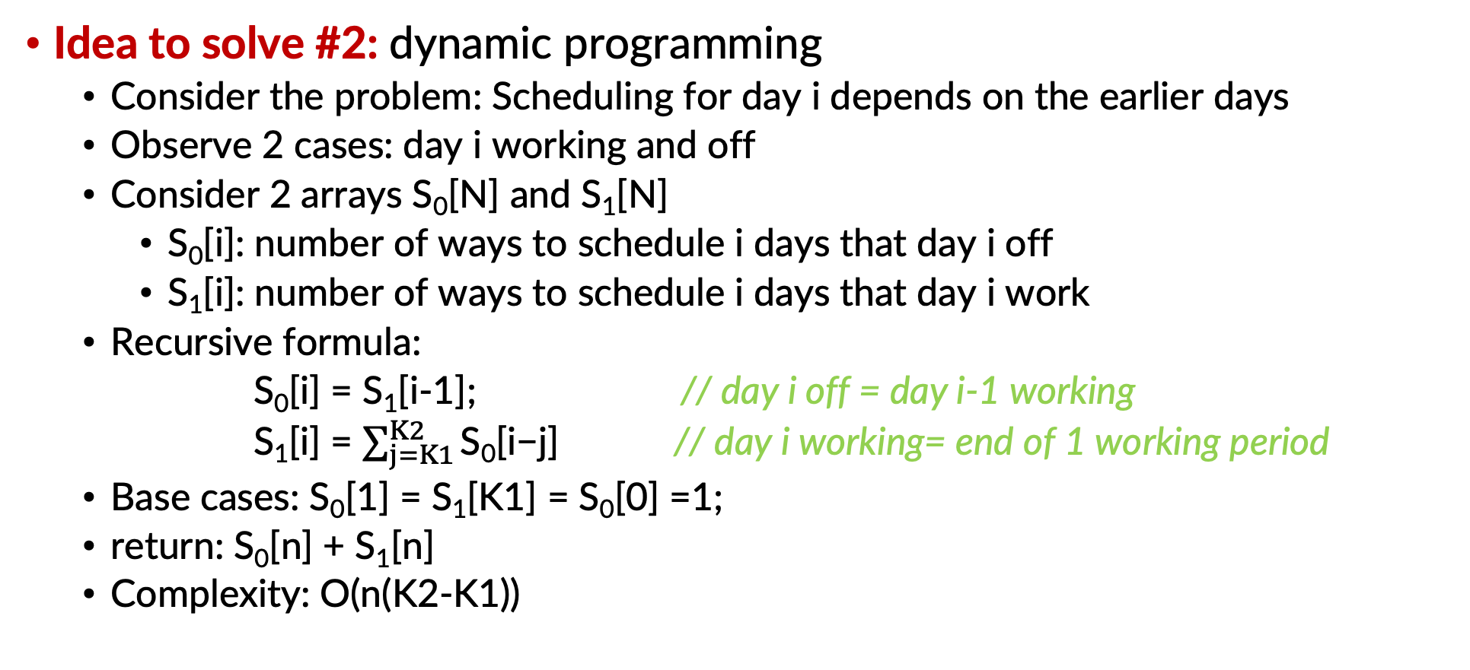
Nurse
Idea to solve #2: dynamic programming
Consider the problem: Scheduling for day i depends on the earlier days
Observe 2 cases: day i working and off
Consider 2 arrays S₀[N] and S₁[N]
S₀[i]: number of ways to schedule i days that day i off
S₁[i]: number of ways to schedule i days that day i work
Recursive formula:
S₀[i] = S₁[i-1]; // day i off = day i-1 working
S₁[i] = $\sum_{j=K1}^{K2}{\text{S}\text{0}\text{[}\text{i}\text{−}\text{j}\text{]}}$ // day i working= end of 1 working period
Base cases: S₀[1] = S₁[K1] = S₀[0] =1;
return: S₀[n] + S₁[n]
Complexity: O(n(K2-K1))

Slide 6
THANK YOU !

